Slide 1
RFdiffusion 1 → 2 → 3
Evolution
Backbone diffusion → Chemistry-aware scaffolding → All-atom generative design

Slide 2
Computational Protein Design
Goal: generate protein or peptide sequences that bind, catalyse, or assemble as desired
Requires searching an enormous sequence and structure space
Design quality depends on geometry, chemistry, and physical plausibility

Slide 3
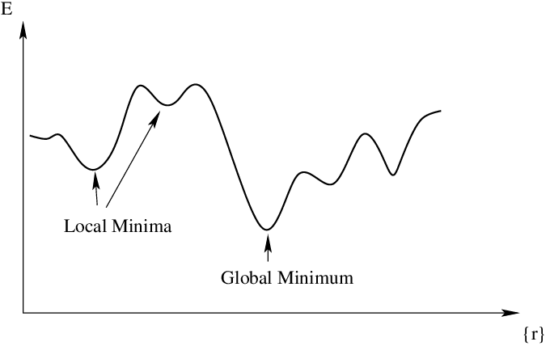
Traditional Protein Design Approaches
Template-based design using known scaffolds
Energy minimisation and sampling with Rosetta
Heuristic mutation and scoring loops
Strong physics bias but limited global exploration

Slide 4
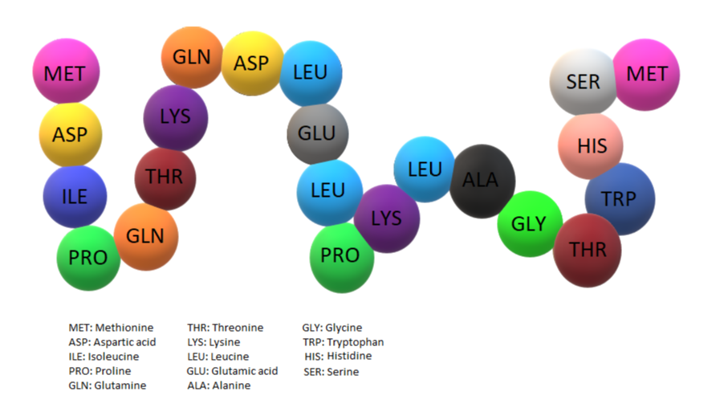
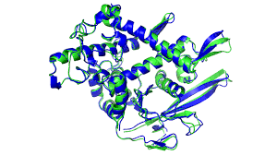
Protein Design Before Diffusion
Sequence-only models trained on natural proteins
Predict structures after proposing sequences
Exploration driven by mutation heuristics
Geometry enforced indirectly via structure prediction

Slide 5
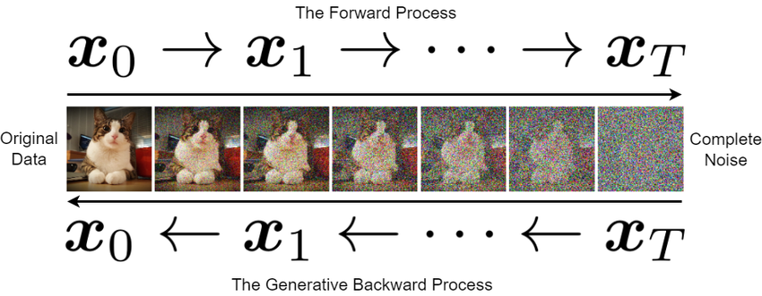
What Diffusion Models Are
Generative models that learn to reverse noise
Trained by corrupting input training data and learning denoising steps
When generating (inference), start from noise and iteratively refine
  DDPM sampling: Add fresh random noise after removing noise
  DDIM sampling: Do not add new random noise (RFDiffusion)

Slide 6
How Diffusion Models Are Trained
During training, model is given a random xᵢ, and predicts the total noise ε used to create xᵢ
Model reasons how noisy xᵢ is relative to the clean data x₀
For each training example:
You start from a clean sample x₀
You pick a random timestep i
You generate xᵢ in one shot by adding noise according to the schedule
The model is given xᵢ and i
The training target is the noise ε that was used to construct xᵢ

Slide 7
What Diffusion Models Are
Naturally suited for structured geometric data:
  Geometric coordinates live in continuous spaces
  Small changes in coordinates correspond to small changes in shape (Smooth transformations)
  When noise is added gradually, local geometric relationships are only slightly perturbed at each step (Local structure preservation)
  Geometric problems often have many valid solutions. Diffusion models learn a full probability distribution over shapes, not a single output

Slide 8
Why Diffusion Works Well for Proteins
Proteins are continuous geometric objects
Local structure depends on global context
Avoids committing early to discrete amino acid sequences
Can operate directly on amino acid coordinates

Slide 9
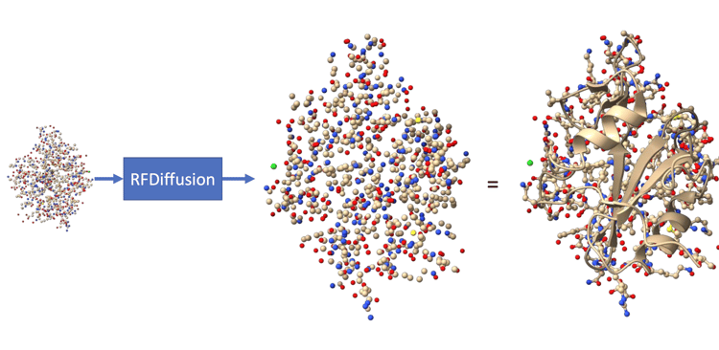
RFdiffusion: Core Idea
Generate protein structures directly, not sequences
Learn protein geometry from large structure datasets
Supports conditional generation via constraints
  Motifs (fixed backbone)
    Protein backbone: Structure of the protein, except side chains
  Interface/contact (bias generation around target protein’s surface, common for binder design)
  Topology/symmetry

Slide 10
RFdiffusion vs Traditional Heuristic Pipelines
Diffusion: Global structure emerges naturally
Heuristics: Structure emerges only if scoring succeeds
Diffusion reduces dependency on getting scoring/filtering criteria right
  Energy functions, heuristic filters, manually tuned variables, etc have to be correct in Traditional approaches
Better coverage of structural space
  Can explore the full range of possible structures

Slide 11
BindCraft (AlphaFold-Guided Mutation)
Starts from random or semi-random sequences
Uses AlphaFold2 to guide the process
Optimises sequences via staged mutation and filtering
Structure emerges through repeated AF2 evaluations
Good for small peptide binders

Slide 12
BindCraft vs RFdiffusion
BindCraft explores sequence space first
RFdiffusion explores structure space first
BindCraft relies heavily on AF2 cost
RFdiffusion has structure knowledge in the model itself

Slide 13
BoltzGen and Related Generative Models
Often focus on ligand or binding energy generation
  Energy landscapes and Boltzmann distributions
Focused on statistical mechanics
Good for:
  Small molecules
  Side chains
Strong chemistry modelling but limited topological freedom
  Also all-atom but assumes mostly fixed backbone
  Can’t easily invent new global folds
Typically not end-to-end structure generators
BoltzGen internalises physical chemistry rules (bond geometry, sterics, and energy landscapes), but assumes topology is mostly fixed

Slide 14
PepMLM and Sequence-First Models
Fine-tuned ESM2(Protein Language Model) on peptide binders
Sequence-first models treat proteins as strings of amino acids, similar to how language models treat text.
Good for motif discovery & sequence statistics
No explicit 3D reasoning/physical foldability
Evaluation done after generation (Bad binders are discarded)
PepMLM: Learns what sequences look like
Rfdiffusion: Learns what structures look like

Slide 15
Diffusion vs Sequence-Only Models
Sequence models learn evolutionary priors
  trained on real-world protein sequences, biased by natural selection and real-world proteins
Diffusion models learn physical geometry
  trained directly on 3D protein structures
Sequence-first risks implausible structures
Diffusion-first enforces realism early
  Enforces geometry at every step of generation

Slide 16
Design Paradigms Compared
Heuristic Approach:
  Mutate then check
Sequence Language Models:
  Propose motifs then check
Diffusion Models:
  Generate valid structure directly
  Don’t need to produce weak candidates that must be heavily fixed later

Slide 17
RFDiffusion Evolution Summary
RFDiffusion1: Backbone diffusion, topology-focused
    Each amino acid residue is represented as a rigid frame (A rotation matrix + translation vector, position+orientation)
  Diffuses backbones
    Side chains/atom types not represented
RFDiffusion2: Backbone diffusion + chemistry-aware losses
  Introduced atom-level conditioning and losses
  Computes losses based on distances/angles/orientations b/w atoms of interest (side chains/ligands)

Slide 18
RFDiffusion Evolution Summary
RFDiffusion3: Full all-atom generative modelling
  Uses ALL atoms (even non-proteins) during diffusion
  Can shape structures at full atomic resolution
  No separate post-hoc steps to make design chemically feasible
    Learns chemically valid arrangements directly instead of approximating them through losses
  Generates interfaces and active sites with coordinated atomic placement across all components
  Produces designs that are immediately suitable for downstream evaluation and filtering
  Enables complex design tasks
    Enzyme active sites
    Ligand binding
    Multi-partner interfaces (DNA & RNA) in a single run

Slide 19



RFDiffusion Evolution Summary
Constraints
RFDiffusion3
Reverse Diffusion (Engine):
  Actual generative power
  Turns noise into protein structure
Constraints (Steering)
  Controls direction, what kinds of structures are made
RFDiffusion 3
Reverse Diffusion

Slide 20
RFdiffusion1 (2023)
Diffusion unit: residue-level rigid-frames
  does not diffuse individual atoms
  Instead, each amino acid residue is represented as a rigid-frame, defined by:
    A rotation matrix
    A translation vector
  This frame corresponds to the position and orientation of that residue’s backbone
Only backbone geometry exists during diffusion
  Side chains, ligands handled after generation
Constraints operate at residue or topology level
Best suited for binders, scaffolds, symmetry, topology design

Slide 21
RFdiffusion1: How it Works
Forward process (training) adds noise to residue frames
  gradually corrupt a real protein backbone by adding noise to their rigid-frames
Reverse process (generation) denoises frames step by step
Model learns protein-like backbone geometry (statistics of a protein structure)
Partial diffusion enables motif preservation
  Residues are split into 2 sets:
    fixed motif residues (kept clean, not noised)
    designable residues (noised and regenerated)
  During generation:
    the motif backbone stays exactly where it is
    the rest of the protein is generated around it
  Enabling preservation of:
    Epitopes, binding loops, etc. while still designing something new
Sequence assigned later using ProteinMPNN

Slide 22
RFdiffusion2 (April 2025): Motivation
Enzyme design requires precise atomic geometry
  Enzymes work because:
    Specific atoms must be positioned with high precision
    Distances, angles, orientations between catalytic atoms matter
    Small geometric errors can kill activity
Residue-level diffusion cannot express chemistry directly
  In RFdiffusion 1:
    The model only sees backbone frames
    Side chains do not exist during diffusion
    Atom types are not represented
  So the model cannot:
    Place catalytic atoms explicitly
    Reason about bond angles or chemistry
    Guarantee correct active site geometry

Slide 23
RFdiffusion2: Motivation
Need to encode catalytic constraints without full atom diffusion
  At the time, full all-atom diffusion was:
    Computationally expensive
    Architecturally complex
    Not yet stable at protein scale
  RFdiffusion 2 introduced a compromise:
    Keep residue-level diffusion
    Inject atom-level information as constraints and losses
  Allowing:
    Active site geometry to influence backbone generation
    Enzyme design to be possible without diffusing every atom

Slide 24
RFdiffusion2: Key Idea
RFdiffusion2 was a bridge b/w RFD1 & 3
RFdiffusion 2 exists because:
  Enzymes demand chemistry
  RFdiffusion 1 only had geometry
  Full atom diffusion wasn’t ready yet

Slide 25
RFdiffusion2: Key Idea
Still diffuses residue frames, not atoms
  Each residue is still a rigid frame
  Only backbone geometry is generated directly
  No side chains or atoms are moved during diffusion
What changed is what the network is conditioned on & trained against
  Introduced atom-level conditioning and losses
  Represents key atoms of interest, such as catalytic side chains or ligands
  Computes losses based on distances/angles/orientations b/w those atoms
  Backpropagates these losses during training and inference guidance
  So even though atoms are not diffused, they affect learning

Slide 26
RFdiffusion2: Key Idea
Backbone generation guided by downstream chemical feasibility
  Because atom-level losses are applied:
    The backbone is encouraged to adopt geometries that could support the desired chemistry
      Backbones that would make correct active site geometry impossible are penalised
    This means backbone generation is no longer purely geometric, it’s biased toward chemically feasible structures
Active site atoms influence diffusion indirectly
  Active site atoms aren’t explicitly generated/moved during diffusion
  They:
    Influence the diffusion trajectory through loss gradients
    Steer backbone frames toward compatible configurations

Slide 27
RFdiffusion2: Limitations
Atomic geometry not explicitly generated, only residue backbones
Side chains still resolved post-hoc
  Side chains are added after backbone generation using separate tools
  correct chemistry is not guaranteed during diffusion
Constraints enforced via loss, not structure
  Chemical requirements are applied as penalties during optimization, rather than being built directly into the generated structure
Complex ligand or multi-partner systems remain difficult
  Systems with multiple interacting components require coordinated atomic placement, which is hard without full all-atom generation

Slide 28
RFdiffusion3 (Dec 2025): An All-atom leap
Enables all-atom generation
Diffusion unit changes from residues to atoms
  No longer moving each amino acid as one rigid backbone ‘frame’
  Diffuses the positions of individual atoms
  Can shape structures at full atomic resolution
Backbone atoms, side chains, ligands, DNA are all explicit
  All components are represented directly as atoms during generation
  Side chains and non-protein partners (DNA) are part of the diffusion itself
    They can be placed in the correct geometry, rather than adding them in later
Single unified generative process
  1 diffusion run produces a complete all atom structure
  No separate post-hoc steps to make design chemically feasible

Slide 29
RFdiffusion3: How it Works
Noise added directly to atomic coordinates
  Each atom has its own 3D position that is perturbed during the forward diffusion process
  Noise reflects realistic spatial uncertainty at the scale of bond lengths and angles
  Learns how valid chemistry degrades under noise
  Enables recovery of fine structural details, not just overall fold
Reverse diffusion denoises full molecular systems
  Generation starts from a noisy atomic configuration for all components at once
  Proteins, binders, ligands, or nucleic acids are refined together in the same process
  Interfaces form naturally as atoms settle into mutually compatible positions
  Eliminates handoff errors between separate backbone, side chain, and docking stages
Covalent geometry and atom types preserved
  Bond connectivity is fixed and known to the model throughout diffusion
  Bond lengths and angles are constrained to remain chemically valid
  Atom identities do not change, preventing unphysical transformations
  Ensures outputs remain within realistic molecular chemistry without heavy filtering
Constraints applied by fixing or biasing atoms directly
  Specific atoms can be held fixed in space, such as a ligand or catalytic residue
  Positional or orientational biases can be applied to selected atoms
  Constraints act during generation, not as post hoc penalties
  Allows precise control over active sites, interfaces, and binding geometry

Slide 30
RFdiffusion3: Training process (all-atom learning)
All-atom training data
  Structures are represented at full atomic resolution, including backbone atoms, side chains, ligands, DNA, and RNA
  Bond connectivity, atom types, and chemical identities are known to the model
  Training data encodes real chemical constraints rather than abstract residue geometry
Forward diffusion
  Random noise is added directly to atomic coordinates over many steps
  Noise degrades structures at multiple scales, from local bond geometry to global fold
  Covalent structure is preserved so molecules remain chemically valid even when noisy
Learning objective
  The model is trained to predict how to reverse atomic noise
  Learns statistics of physically plausible atomic arrangements
  Internalizes how interfaces, binding pockets, and active sites are formed and maintained
  Does not rely on energy functions or heuristic scoring during learning

Slide 31
RFdiffusion3: Generation (inference) process
Input and conditioning
  Target molecules are provided as fixed or partially flexible atomic structures
  Designable regions and non-protein partners are explicitly defined
  Constraints specify which atoms must remain fixed, flexible, or biased
Reverse diffusion
  Generation begins from a noisy atomic configuration
  At each step, the model refines atom positions toward chemically-valid structures
  All components evolve together, allowing interfaces to emerge naturally
Constraint enforcement
  Constraints act directly on atoms rather than through penalty terms
  Fixed atoms serve as physical anchors during generation
  Biases guide binding geometry, orientation, and contact formation
Output
  A complete all-atom structure is produced
  Side chains, ligands, and nucleic acids are already placed
  Designs are chemically feasible by construction
  Downstream steps focus on evaluation and selection

Slide 32
RFDiffusion3: Reverse diffusion
Initial state: Noisy atomic configuration
  Noisy atomic configuration for designable atoms
  Fixed atoms embedded inside the noise cloud
  Atom identities and bonds unchanged
  Sequence is not required at the start:
    Represents every residue with a fixed atom budget (4 backbone + 10 side chain atoms) and using ‘virtual atoms’ when a residue has fewer side chain atoms, so the diffusion state always has the same tensor shape even when sequence is unknown
  Not everything is necessarily randomised. In conditional design, parts of the system can be provided as exact coordinates within the developing noise cloud. That means the overall state may be partly noisy (design regions) and partly exact (motif, target, ligand, nucleic acid, etc.), depending on the task
  At the start of inference, the designable atoms are a cloud that is statistically consistent with the training noise distribution at the highest noise level, while fixed or conditioned atoms can already be sitting where they must end up.
Iterative denoising: At each step, the model refines atom positions toward chemically valid structures
  Each reverse-diffusion step is a repeated “predict then update” loop
    The model sees: current noised coordinates at time step t plus conditioning features (if any). The model predicts: a denoised estimate or an update direction for atomic coordinates (reconstructing structure from noised inputs)
    A diffusion scheduler updates coordinates: the sampler combines the model’s prediction with the known noise schedule to produce the next coordinates at step t-1
  Chemically plausible outputs
    Covalent structure is baked into the representation. Because atoms have types and residues have a defined backbone plus side chain atom scaffold (with virtual atoms when needed), the network learns distributions of geometries that correspond to real molecules, rather than just ‘points in space.’
    Local interactions are emphasised. Sparse, distance-based attention between atomic and token features are used so the network focuses on local atomic neighbourhoods that matter for sterics, packing, bonding constraints
  Early steps mainly decide global layout (where the chain goes in space), mid steps lock in secondary structure and interfaces, late steps sharpen side chain placement and the exact atomic contacts
All components evolve together, allowing interfaces to emerge naturally
  Proteins and partners can be part of one joint denoising system
  Interface formation: If two components are present during denoising, the model can shape them so that complementary surfaces and atomic contacts appear as a direct consequence of the joint reverse process
  Coupling happens through network architecture repeated information exchange between atom-level features and residue-level “token” features (cross attention pooling), so local atomic constraints and broader fold decisions influence each other during sampling
  The same learned denoising operation is simultaneously making each component more structured and making the mutual arrangement more compatible

Slide 33
RFDiffusion3: Constraint enforcement
Constraints act directly on atoms, rather than through penalty terms
  RFD2’s key limitation was that chemistry influenced backbone through losses and guidance, while diffusion itself stayed at residue frames
  Constraints can be expressed as atomic facts, not abstract objectives
    Because all polymer atoms are modeled explicitly, conditioning on complex sets of atom-level constraints is simpler and more effective, (e.g. hydrogen bonding roles, per-atom solvent accessibility labels)
  Motifs and binding partners can be injected as exact coordinates
  Classifier-free guidance strengthens constraint adherence
    At each denoising step, RFD3 can run one conditional forward pass and one unconditional forward pass, then take a weighted combination to bias samples toward satisfying the constraints. This is a direct, per-step steering mechanism, not a separate penalty optimisation loop
  Primary enforcement mechanism is structural conditioning and guided denoising
Fixed atoms serve as physical anchors during generation
  When you fix atoms:
    They define an invariant reference frame. The designable atoms are repeatedly updated around these fixed coordinates, so the model learns to “wrap” structure around the anchor rather than drifting arbitrarily in space
    They reduce ambiguity early in the trajectory. Early diffusion steps are very underdetermined. Anchors constrain the space of plausible global layouts and docking modes, so later refinement has a much easier job
    They preserve exact geometry where function demands it. For enzymes, small molecules, and nucleic acid recognition, small coordinate errors matter. Anchoring is the blunt but effective way to guarantee that the functional atoms do not move
    Trimming a target down to the binding region often works well: you are giving the model a clean, fixed anchor with fewer irrelevant atoms competing for attention
Biases guide binding geometry, orientation, and contact formation
  RFD3 offers multiple ways to ‘bias’ without turning inference into an optimisation problem:
    Classifier-free guidance (CFG) as a steering knob. Increasing guidance weight makes the denoising trajectory adhere more strongly to the conditioning information
    Atomic hydrogen bond conditioning. The model can be told which partner atoms are donors or acceptors, so the generated protein places complementary donors or acceptors in the right places
    Per-atom solvent accessibility labels to control how buried ligand atoms become, which indirectly but strongly biases pocket geometry and contact density
    Center-of-mass and coarse placement biases. RFD3 can condition on where the protein’s center-of-mass should lie relative to a target or motif, which biases the overall orientation and approach vector before fine interface details form
    Symmetry bias by symmetrizing the trajectory, constrain the global arrangement so interfaces and contacts must respect symmetry
  ‘Bias’ in RFD3 is usually implemented as additional conditioning features plus CFG, which changes the denoising field at every step so that the random sample is continually pulled toward the desired interface geometry.

Slide 34
Foundry: https://github.com/RosettaCommons/foundry
an integrated system for end to end molecular design
Foundry is the unified design pipeline built around RFdiffusion 3
  An integrated system for end-to-end molecular design
RFdiffusion 3 is the generative core
  Produces full all atom structures
  Handles folding, interfaces, and chemistry during generation
  Acts as the engine of the pipeline
Foundry is the orchestration layer
  Defines how RFdiffusion 3 is conditioned and run
  Manages constraints, anchors, and design regions
  Connects generation to downstream steps coherently

Slide 35
Why Foundry Exists
All-atom generation requires unified pipelines
Structure generation, sequence design, folding must align
Foundry integrates RFD3, ProteinMPNN, RosettaFold3 (RF3)
RFdiffusion3
  Generates atomic structures
  Handles constraints and interface formation
ProteinMPNN
  Assigns sequences compatible with generated backbones
  Respects atomic context from RFdiffusion output
RF3 is a structure predictor, similar in role to AlphaFold
  Takes sequence (and sometimes initial coordinates)
  Predicts a folded structure
  Outputs confidence metrics
Structure validation
  Folding or relaxation tools aligned with generation assumptions
  Used for filtering, not rescue
Constraint and metadata handling
  Tracks which atoms were fixed or biased
  Preserves design intent across steps

Slide 36
Implementation:
IPD Design Pipeline
Input: Target Structure + Constraints
RFDiffusion3 (Structure generation)
  RFD3 performs all-atom diffusion
  Outputs:
    A full atomic structure backbone + side-chain atoms
    Correct topology
    But no meaningful amino acid identities yet
ProteinMPNN (sequence design)
  takes the fixed backbone geometry
  predicts a probability distribution over amino acids per position
  Outputs 1 or many (usually hundreds) of candidate sequences per backbone
RosettaFold3
  RF3 is a structure predictor (like AlphaFold)
  Takes sequence (and sometimes initial coordinates)
  Predicts a folded structure
  Outputs confidence metrics
Final Outputs:
  Protein sequences (ranked)
  Predicted folded structure (pdb)
  Confidence/quality metrics

Slide 37
MutaCraft vs BindCraft Benchmark
In the BindCraft paper, Binding affinity was measured in apparent dissociation constant (Kd):
  Specific molar concentration of the binder at which half of the target protein’s binding sites are occupied at equilibrium
  Measured in nanomolar(nm):
    number of moles of binder per liter of solution
The worst-performing target protein was CD45 (720 nM)
The best-performing target protein was Der f 7 (12.8 nM)

Slide 38
MutaCraft vs BindCraft Benchmark
I tested MutaCraft’s performance vs BindCraft on both these proteins to show that it can improve performance in the best and worst-case
Same hyperparameters (num AF2 models, num recycles)
For MutaCraft, regular BindCraft was run for 3 trajectories, and the best binder was selected for the input binder (warm start)

Slide 39
MutaCraft vs BindCraft Results
For plddt and iptm, higher is better
CD45 (worst)
Der f 7 (best)
Algorithm | plddt_mean | plddt_max | plddt_min | plddt_q25 | plddt_q50 | plddt_q75 | ipTM_mean | ipTM_max | ipTM_min | ipTM_q25 | ipTM_q50 | ipTM_q75 | duration_mean | AlphaFold2_calls_mean
BindCraft | 0.522 | 0.58 | 0.47 | 0.4925 | 0.525 | 0.5475 | 0.414 | 0.46 | 0.36 | 0.3925 | 0.415 | 0.4375 | 538.8 | 75
MutaCraft | 0.585 | 0.63 | 0.54 | 0.5625 | 0.585 | 0.6075 | 0.485 | 0.51 | 0.46 | 0.4725 | 0.485 | 0.4975 | 434.4 | 78
Algorithm | plddt_mean | plddt_max | plddt_min | plddt_q25 | plddt_q50 | plddt_q75 | ipTM_mean | ipTM_max | ipTM_min | ipTM_q25 | ipTM_q50 | ipTM_q75 | duration_mean | AlphaFold2_calls_mean
BindCraft | 0.678 | 0.73 | 0.61 | 0.655 | 0.685 | 0.7075 | 0.433 | 0.49 | 0.38 | 0.4025 | 0.43 | 0.465 | 431 | 71.2
MutaCraft | 0.766 | 0.8 | 0.73 | 0.7525 | 0.765 | 0.78 | 0.476 | 0.52 | 0.44 | 0.4625 | 0.475 | 0.4875 | 354.6 | 70

